Slide 1
Year 8 - GEOGRAPHY

Slide 2
What is Geography?
Geography is the subject that helps us to find answers to questions about the world around us.

Slide 3
The word ‘geography’…
The word ‘geography’ can be divided into two parts, ‘geo’ and ‘graphy’.
‘Geo’ comes from the Greek word ‘ge’, meaning ‘Earth’.
‘Graphy’ comes from ‘graphein’, which means ‘to describe’.

Slide 4
More about geography…
Geography is essentially the temporal (relating to time) and spatial (relating to space) study of people and places in the world.
Geography can be divided into two main branches:
* Physical geography
* Human (or cultural) geography

Slide 5
Physical Geography
Generally classified as an Earth science.
Studies the physical features and environments of the Earth.
Examples: Rivers, volcanoes, _________________, _____________________.

Slide 6
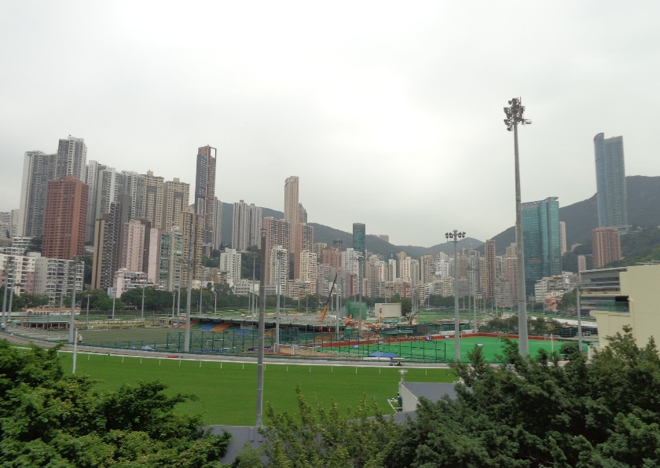
Human Geography
Usually referred to as a social science.
Studies the way that humans interact with and have an impact on each other and the Earth.
Examples: Study of towns, farms, cities and megacities (a city with a population of over 10 million people).

Slide 7
Explanation –
Why do we study Geography?
Geography helps us to explain how the world looks the way it does, where things are (location/situation) and how they got there (reasons/account for).

Slide 8
Importance of Geography
Geography is concerned with the processes that shape the earth’s surface and
the way people interact with the environment.
The study of geography helps us to better understand the world in which we live.

Slide 9
What do geographers do?
The role of a geographer is to ask questions about the people and places in the world, plus find answers to these questions.
Key questions:
Where is it?
How did it get there?
Why is it there?
Has it changed over time?
What is it affecting and how is it being affected?

Slide 10
How do geographers find answers?
Geographers find answers to their questions by collecting i________________ called d________.
Data can be collected in a number of ways, including observation and questioning.
Geographical data is often collected outdoors, in the natural or physical environment. This kind of study is known as fieldwork.

Slide 11
Tools used in Geography
The most common tools include:
Maps
Photographs
Tables
Charts
Graphs (Types: _____________, ___________________, _________________)
Models
Surveys and Questionnaires

Slide 12
Brainstorm
What are some other tools Geographers use to find information about our world?

